Slide 1

SOCIAL CONFLICTS DYNAMICS AND EFFECTS ON LIVELIHOODS IN THE PASTORAL AND AGRO-PASTORAL COMMUNITIES OF KARAMOJA CLUSTER
Derick Ansyijar Kuule
PhD Student
Department of Environmental Management, Makerere University
Supervisors: Anthony Egeru, Alice Turinawe & Barbara Schumann

Slide 2
Research objectives
Main objective
To assess the drivers of social conflicts and their effects on livelihoods at household and community level based on the local contexts
Specific objectives
Assess the determinants of social conflicts
Determine the effect of social conflicts on asset accumulation
Explore the role of local institutions on social conflicts’ compromise and escalation

Slide 3
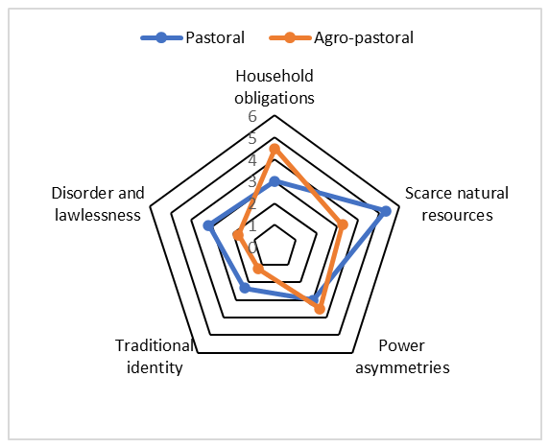


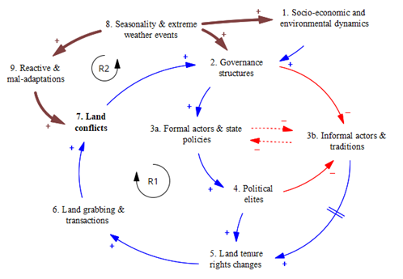



Submitted paper: Multi-dimensionality and interconnectedness of social conflicts in the Karamoja sub-region in northeastern Uganda
Methods and materials
Mixed methods approach
Female and male-separated FDGs
using rural participatory approaches
Findings
Five themes defined conflicts
in Karamoja
Conflicts revealed gender
dimensions
Interlinkages in conflicts revealed
Seasonal shifts in
conflicts observed
Conclusion:
Community perspectives unraveled great insights into social conflict patterns.
Seasonal dynamics and interconnected conflict drivers are worthy considerations for conflict interventions

Slide 4
Current paper: DETERMINANTS OF SOCIAL CONFLICTS IN NORTH-EASTERN UGANDA AND NORTH-WESTERN KENYA.
Type of Data | Data collection method | Data analysis method | Data source
Occurrence of social conflicts & determinants | Structured interviews | Binary response model (Probit) | Baseline and follow-up survey
Forms of social conflicts & determinants | Structured interviews | Multivariate probit regression Analysis | Baseline and follow-up survey
Seasonality of social conflicts | Satellite data Structured interviews | Descriptive statistics | NASA Power satellite rainfall

Slide 5
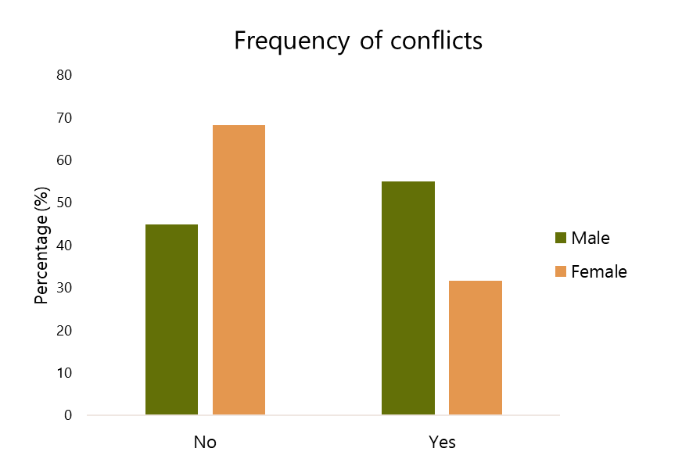
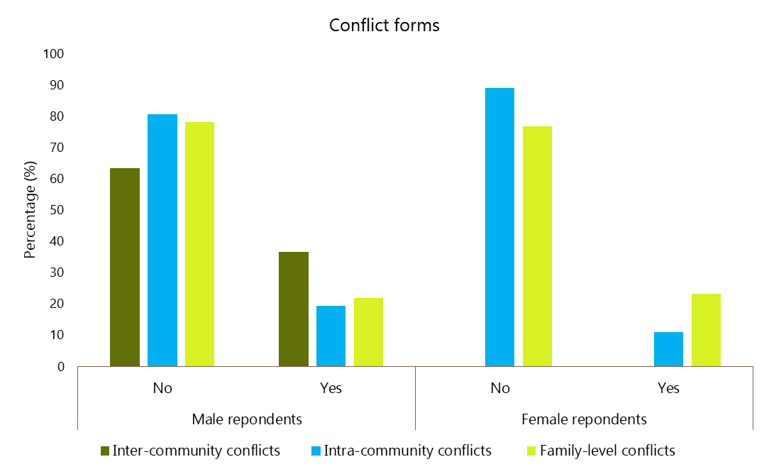
Preliminary findings

Slide 6
Conflict determinants (Male respondents; 74% correctly specified )
 | dy/dx | z | P>z
Country () | 0.4511659 | 9.52 | 0.000
Age-set/group
36-60years | 0.0290818 | -0.98 | 0.328
Above 60years | -0.0468665 | -0.84 | 0.399
HH type | -0.1435601 | -2.38 | 0.017
HH livelihood type
Crop-dependent | 0.0949931 | 1.38 | 0.167
Both crop & livestock dependent | 0.1014013 | 1.80 | 0.072
Off-farm | -0.0110023 | -0.18 | 0.859
Baseline total rainfall | 0
Migration with livestock | 0.0884845 | 2.73 | 0.006
Human migration | 0.1178177 | 3.44 | 0.001
Wet season crop land acreage | -0.001832 | -0.46 | 0.648
Wet season livestock land acreage | 0.0021268 | 4.25 | 0.000
Excessive alcohol consumption | 0.0408995 | 0.70 | 0.487
HH income control
Wife | -0.1081628 | -1.77 | 0.077
Both husband and wife | -0.0029773 | -0.09 | 0.924
Children/relatives | -0.123676 | -1.14 | 0.254

Slide 7
Conflict determinants (Female respondents; 70% correctly specified )
Delta-method
 | dy/dx | Std. Err. | P>z
Study site (Chepareria)
Lokiriama | -0.04334 | 0.056445 | 0.443
Matany | 0.251561 | 0.056126 | 0.000***
Rupa | 0.111394 | 0.055217 | 0.044**
Family origin (out of area) | -0.10896 | 0.035188 | 0.002***
Migration with livestock (No) | -0.05811 | 0.034506 | 0.092
HH income control (Husband)
Wife | 0.042976 | 0.065132 | 0.509
Both husband and wife | 0.061809 | 0.032988 | 0.061
Children & relatives | 0.152636 | 0.13769 | 0.268
HH type, HH livelihood type, Age-set, Human migration, Wet season crop land acreage, Excessive alcohol consumption, Income work

Slide 8
Inter-community conflicts (Male respondents )
 | dy/dx | Std. Err. | P>z
Country | 0.081437 | .1531744 | 0.595
Baseline ppt | -0.00113 | .000246 | 0.000
Age-set/group
36-60years | -0.03798 | .026958 | 0.159
Above 60years | -0.00955 | .0454408 | 0.834
HH type | 0.031708 | .0416112 | 0.446
2.Studysite | 0 | (not estimable)
Family origin | -0.06457 | .0308174 | 0.036
HH livelihood type
Crop-dependent | 0.091938 | .0554504 | 0.097
Both crop & livestock dependent | 0.072783 | .046832 | 0.12
Off-farm | -0.07148 | .0497033 | 0.15
Livestock migration | 0.035263 | .0290744 | 0.225
Human migration | 0.108133 | .0278543 | 0.000
Wet season cropland acreage | 0.00082 | .0035237 | 0.816
Dry season livestock land acreage | 0.003268 | .0003559 | 0.000

Slide 9
WAY FORWARD
Date | 1st Manuscript (Dimensionality & interconnectedness of social conflicts in Karamoja Sub-region northeastern Uganda) | 2nd Paper (Determinants of social conflicts in northeastern and northwestern Uganda) | 2nd & 3rd objectives analysis | Thesis, writing corrections and eidts, presentation at department, school, corrections | Thesis submission for examination | Viva; Thesis final edits and Final submissions
May 22- July 22
Aug 22 - March 23
Feb-June 23
July-August 23
Sept -Dec 23
Jan-24
Feb-March 24
April-June 24
July-Aug 24
Sept-Dec 24
Jan-Feb-25
March-May 25
June-Aug 25
Sept-Nov 25

